Slide 1
Lecture 8
Metric Learning and Siamese Nets
Notes:
Siamese = 2 bodies born physically connected.
*DERIVED FROM THE SIAMESE TWINS! → the medical term is called “conjoined twins”

Slide 2
Learning Pairwise Similarity Scores
Reference:
Bromley et al. Signature verification using a Siamese time delay neural network. In NIPS. 1994.
Koch, Zemel, & Salakhutdinov. Siamese neural networks for one-shot image recognition. In ICML, 2015.

Slide 3
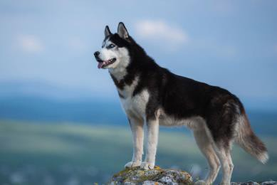
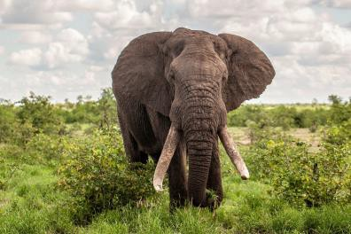
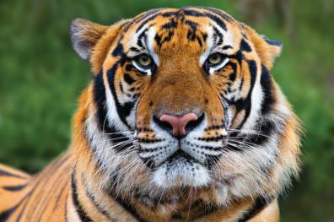
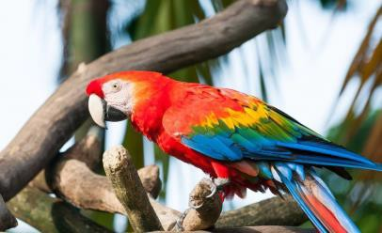
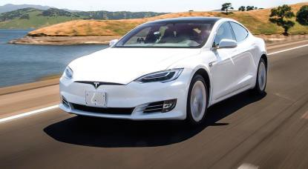
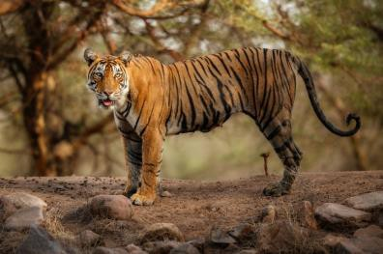
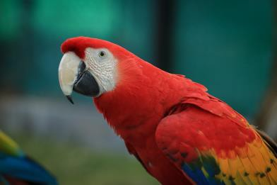
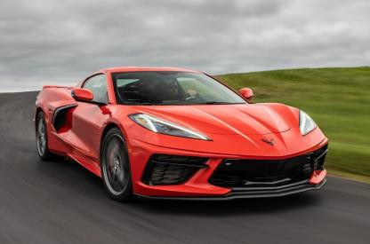
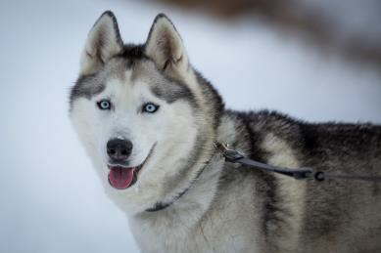
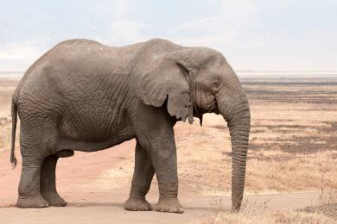
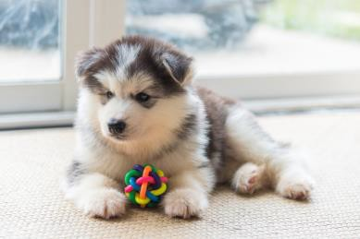
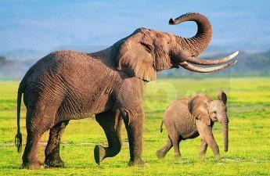
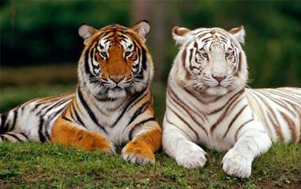
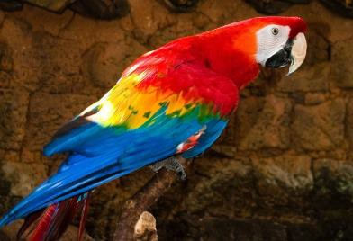

Training Set
Husky
Elephant
Tiger
Macaw
Car
⋮
⋮
⋮
⋮
⋮

Slide 4
Training Data
Positive Samples
Negative Samples

Slide 5
Training Data
Positive Samples
Negative Samples

Slide 6
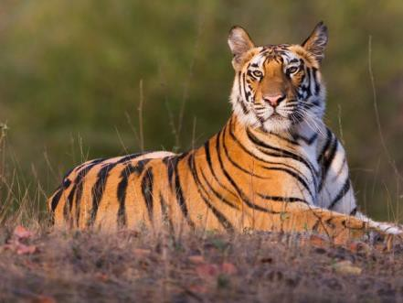
Training Data
Positive Samples
Negative Samples

Slide 7
Training Data
Positive Samples
Negative Samples
( , , 1)

Slide 8

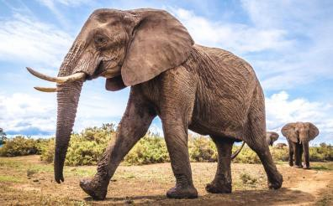
Training Data
Positive Samples
Negative Samples
( , , 1)
( , , 1)
•(
,
,
1)
Notes:
Positive samples tell the model which things are in the same class/kind
Negative sample tells what are the different classes
Similar to classic classification.

Slide 9
Training Data
Positive Samples
Negative Samples
( , , 1)
( , , 1)
•(
,
,
1)

Slide 10
Training Data
Positive Samples
Negative Samples
( , , 1)
( , , 1)
•(
,
,
1)

Slide 11
Training Data
Positive Samples
Negative Samples
( , , 1)
( , , 1)
( , , 0)
•(
,
,
1)

Slide 12
Training Data
Positive Samples
Negative Samples
( , , 1)
( , , 1)
( , , 0)
, , 0)
(
•(
•(
,
,
1)
,
,
0)
Notes:
Positive samples tell the model which things are in the same class/kind
Negative sample tells what are the different classes
Similar to classic classification.
1=true = same class
0=false=different classes

Slide 13




CNN for Feature Extraction
Conv, Pool
Conv, Pool
Flatten
𝐱
𝐟 𝐱
Notes:
Flatten= create feature vector.

Slide 14
Training Siamese Network
𝐱₁
𝐱₂

Slide 15
Training Siamese Network
𝐟
𝐱1
𝐟
𝐱2

Slide 16
Training Siamese Network
𝐟
𝐱1
𝐡1 = 𝐟 𝐱1
𝐟
𝐱2
𝐡2 = 𝐟 𝐱2

Slide 17
Training Siamese Network
𝐟
𝐱1
𝐡1
𝐟
𝐳 = 𝐡1 − 𝐡2
𝐱2
𝐡2
Notes:
f is a function with the same parameter weights.
Z= difference vector.

Slide 18

Training Siamese Network
𝐟
𝐱1
Dense Layers
𝐡1
𝐟
𝐳
𝐱2
𝐡2

Slide 19
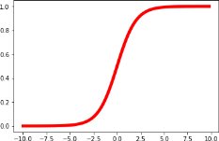
Training Siamese Network
𝐟
𝐱1
Dense Layers
𝐡₁
Sigmoid
𝐟
𝐳
𝐱2
𝐡2

Slide 20
Training Siamese Network
𝐟
𝐱1
Dense Layers
𝐡₁
Sigmoid
sim 𝐱1, 𝐱2
𝐟
𝐳
𝐱2
𝐡2

Slide 21
Training Siamese Network
Target = 1
𝐟
𝐱1
Dense Layers
𝐡₁
Sigmoid
sim 𝐱1, 𝐱2
𝐟
𝐳
𝐱2
𝐡2

Slide 22
Training Siamese Network
Target = 1
Loss
𝐟
𝐱1
Dense Layers
𝐡₁
Sigmoid
sim 𝐱1, 𝐱2
𝐟
𝐳
𝐱2
𝐡2

Slide 23
Training Siamese Network
Target = 1
Loss
𝐟
𝐱1
Dense Layers
𝐡₁
Sigmoid
sim 𝐱1, 𝐱2
𝐟
𝐳
𝐱2
𝐡2
Notes:
We want output to be close to 1 if they are in the same class, closer to 0 if not.
We want target and output to be close; their difference = LOSS
Of course we aim to minimize loss → use back propagation to calculate gradient → update f.
Note that f is from the same CNN, so the f is the same for both h1 and h2.

Slide 24
Training Siamese Network
Loss
𝐟
• Target = 1
• Sigmoid
• sim 𝐱1, 𝐱2
•
Dense Layers
𝐟
𝐳

Slide 25
Training Siamese Network
Loss
𝐟
• Target = 1
Dense Layers
𝐟
𝐳
Notes:
Remember: the same f is used, so the arrows are point to the two f’s, but it is just denoting both f’s are updated because they are the same, and they will be used for next pair input.

Slide 26
Training Siamese Network
Target = 0
Loss
𝐟
𝐱1
Dense Layers
𝐡₁
Sigmoid
sim 𝐱1, 𝐱2
𝐟
𝐳
𝐱2
𝐡2

Slide 27
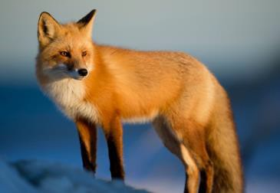
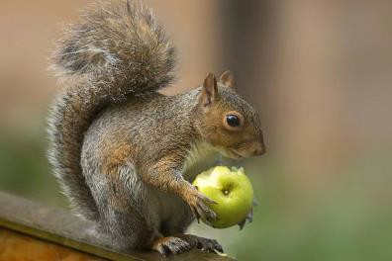
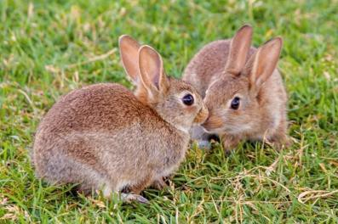
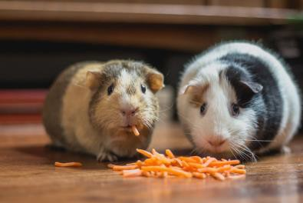
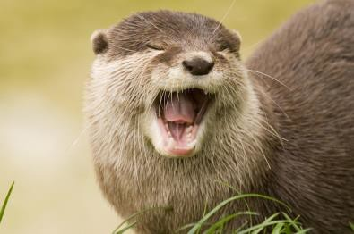
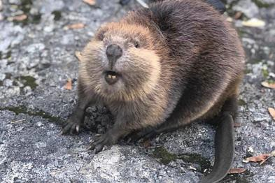
One-Shot Prediction
6-way 1-shot prediction: support set has 6 test classes; each class has 1 sample.
The training data (for the Siamese network) does not contain the 6 classes.
Support Set:
Rabbit Hamster
Fox
Squirrel
Otter
Beaver
Notes:
Support set is not in the training set.

Slide 28
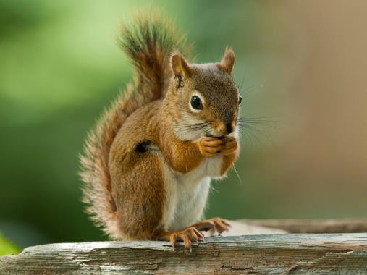
One-Shot Prediction
Query:
Support Set:
Rabbit Hamster
Fox
Squirrel
Otter
Beaver

Slide 29
One-Shot Prediction
Query:
Fox
Squirrel
Rabbit
Hamster
Otter
Beaver

Slide 30
One-Shot Prediction
Query:
sim = 0.2
Fox
Squirrel
Rabbit
Hamster
Otter
Beaver

Slide 31
One-Shot Predicti
Query:
on
sim = 0.2
sim = 0.9
Fox
Squirrel
Rabbit
Hamster
Otter
Beaver

Slide 32
One-Shot Predicti
Query:
on
sim = 0.2
sim = 0.9
sim = 0.7
sim = 0.5
sim = 0.3
sim = 0.4
Fox
Squirrel
Rabbit
Hamster
Otter
Beaver

Slide 33
One-Shot Predicti
Query:
on
sim = 0.9
Squirrel
sim = 0.2
sim = 0.7
sim = 0.5
sim = 0.3
sim = 0.4
Fox
Rabbit
Hamster
Otter
Beaver
Notes:
Feed (squirrel, fox/squirrel/etc.) pairs to the Siamese network for comparison → choose highest similarity output.

Slide 34
Triplet Loss
Reference:
Schroff, Kalenichenko, & Philbin. Facenet: A unified embedding for face recognition and clustering. In
CVPR, 2015.

Slide 35
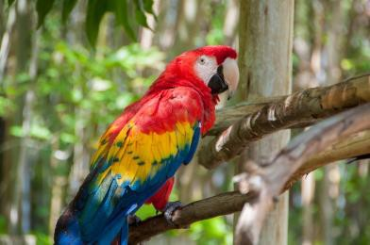
Data for Training Siamese Network
Training Set
Elephant Tiger Macaw
Car

Slide 36
Data for Training Siamese Network
Training Set
Elephant Tiger Macaw
Car
anchor

Slide 37
Data for Training Siamese Network
Training Set
Elephant Tiger Macaw
Car
anchor
Notes:
Choose anchor

Slide 38
Data for Training Siamese Network
Training Set
Elephant Tiger Macaw
Car
Positive
Notes:
Choose positive sample → meaning a sample from same class as anchor

Slide 39
Data for Training Siamese Network
Training Set
Elephant Tiger Macaw
Car
Positive

Slide 40
Data for Training Siamese Network
Training Set
Elephant Macaw
Car
Negative
Notes:
Then choose negative sample → a sample different from anchor.

Slide 41
Data for Training Siamese Network
Training Set
Elephant Tiger Macaw
Car
Negative

Slide 42
Triplet Loss
𝐱+
(positive)
𝐱a
(anchor)
(negative)
𝐱-

Slide 43

Triplet Loss
𝐟
𝐱+
(positive)
𝐟
𝐱a
(anchor)
𝐟
(ne^{𝐱}ga⁻tive)

Slide 44
Triplet Loss
𝐟
𝐱+
(positive)
𝐟 𝐱+
𝐟
𝐱a
(anchor)
𝐟 𝐱a
𝐱-
(negative)
𝐟
𝐟
𝐱-
Notes:
F could be resnet, vgg → some CNN; remember F is the same for all three images to get f(x).

Slide 45
Triplet Loss
𝐟
𝐱+
(positive)
𝐟 𝐱+
2
2
𝑑⁺ =
𝐟 𝐱+ − 𝐟 𝐱a
𝐟
𝐱a
(anchor)
𝐟 𝐱a
𝐱-
(negative)
𝐟
𝐟
𝐱-

Slide 46
Triplet Loss
𝐟
𝐱+
(positive)
𝐟 𝐱+
2
2
𝑑⁺ =
𝐟 𝐱+ − 𝐟 𝐱a
𝐟
𝐱a
(anchor)
𝐟 𝐱a
2
2
𝑑⁻ =
𝐟 𝐱a
− 𝐟 𝐱-
𝐱-
(negative)
𝐟
𝐟 𝐱-

Slide 47
Triplet Loss
Feature Space
𝐱+
(positive)
𝐱a
(anchor)
𝐱-
(negative)
𝐟
𝐱a

Slide 48
Triplet Loss
Feature Space
𝐱+
(positive)
𝐱a
(anchor)
𝑑+
𝐟 𝐱⁺
𝐱-
(negative)
𝐟
𝐱a

Slide 49
Triplet Loss
Feature Space
𝐱+
(positive)
𝐟 𝐱-
𝑑-
𝐱a
(anchor)
𝑑+
𝐟 𝐱⁺
𝐟 𝐱a
(ne^{𝐱}ga⁻tive)

Slide 50
Triplet Loss
2
2
2
2
𝐱+
(positive)
Encourage 𝑑⁺ =
Encourage 𝑑⁻ =
𝐟 𝐱+ − 𝐟 𝐱a
𝐟 𝐱ª − 𝐟 𝐱⁻
to be small.
to be big.
𝐱a
(anchor)
𝐱-
(negative)

Slide 51
Triplet Loss
2
2
2
2
𝐱+
(positive)
Encourage 𝑑⁺ =
𝐟 𝐱+ − 𝐟 𝐱a
to be small.
Encourage 𝑑⁻ = 𝐟 𝐱a − 𝐟 𝐱-
to be big.
If 𝑑⁺ ≥ 𝑑⁻ + 𝛼, then no loss. (𝛼 > 0 is margin.)
Otherwise, the loss is 𝑑⁺ + 𝛼 − 𝑑⁻.
_{𝐱}a
(anchor)
𝐱-
(negative)

Slide 52
Triplet Loss
2
2
2
2
𝐱+
(positive)
Encourage 𝑑⁺ =
𝐟 𝐱+ − 𝐟 𝐱a
to be small.
Encourage 𝑑⁻ = 𝐟 𝐱a − 𝐟 𝐱-
to be big.
If 𝑑⁺ ≥ 𝑑⁻ + 𝛼, then no loss. (𝛼 > 0 is margin.)
Otherwise, the loss is 𝑑⁺ + 𝛼 − 𝑑⁻.
_{𝐱}a
(anchor)
Loss 𝐱a, 𝐱+, 𝐱- = max 0, 𝑑⁺ + 𝛼 − 𝑑⁻ .
𝐱-
(negative)
• Update the CNN (function 𝐟) to decrease the loss.

Slide 53
One-Shot Predicti
Query:
on
Support Set:
Rabbit Hamster
Fox
Squirrel
Otter
Beaver

Slide 54
One-Shot Predicti
Query:
on
dist = 231
Fox
Squirrel
Rabbit
Hamster
Otter
Beaver

Slide 55
One-Shot Predicti
Query:
on
dist = 231
dist = 19
Fox
Squirrel
Rabbit
Hamster
Otter
Beaver

Slide 56
One-Shot Prediction
Query:
dist = 231
dist = 19
dist = 138
dist = 76
dist = 122
dist = 94
Fox
Squirrel
Rabbit
Hamster
Otter
Beaver

Slide 57
One-Shot Predicti
Query:
on
dist = 19
Squirrel
dist = 231
dist = 138
dist = 76
dist = 122
dist = 94
Fox
Rabbit
Hamster
Otter
Beaver

Slide 58
Summary

Slide 59
Basic Idea of Few-Shot Learning
Train a Siamese network on large-scale training set.
Given a support set of 𝑘-way 𝑛-shot.
𝑘-way means 𝑘 classes.
𝑛-shot means every class has 𝑛 samples.
The training set does not contain the 𝑘 classes.
Given a query, predict its class.
Use the Siamese network to compute similarity or distance.

Slide 60
Siamese Network for Pairwise Similarity
Target = 1
Loss
𝐟
𝐱1
Dense Layers
𝐡₁
Sigmoid
sim 𝐱1, 𝐱2
𝐟
𝐳
𝐱2
𝐡2

Slide 61
Siamese Network with Triplet Loss
𝐟
𝐱+
(positive)
𝐟 𝐱+
2
2
𝑑⁺ =
𝐟 𝐱+ − 𝐟 𝐱a
𝐟
𝐱a
(anchor)
𝐟 𝐱a
2
2
𝑑⁻ =
𝐟 𝐱a
− 𝐟 𝐱-
-
𝐟
𝐱
𝐟 𝐱-
(negative)

